Slide 1
INTRODUCTION TO HDL- HARDWARE DESCRIPTION LANGUAGE
Describes the hardware functionality of the Digital Systems in the textual form
It resembles programming language, but is specially developed for describing the functionality of the Digital hardware
The main difference with other high-level languages is
HDL’s constructs ability to perform parallel execution
Unlike sequential execution nature of other language constructs
Two HDLs are widely used
Verilog HDL
VHDL(Very High Speed Integrated Circuit HDL)

Slide 2
LEXICAL CONVENTIONS
Verilog is a free-format language
Like C language
White space (blank, tab, newline) can be used freely
Verilog is a case-sensitive language
Identifiers
An identifier is used as an object reference. An identifier can contain a sequence of letters, digits, underscores (_) and dollar signs ($). The first character of an identifier can only be a letter or an underscore. Identifiers are case sensitive.
User-provided names for Verilog objects in the descriptions
Legal characters are “a-z”, “A-Z”, “0-9”, “_”, and “$”
First character has to be a letter or an “_”
Example: Count, _R2D2, FIVE$

Slide 3
LEXICAL CONVENTIONS –Contd.
Keywords
Predefined identifiers to define the language constructs
All keywords are defined in lower case
Cannot be used as idenfiers
Example: initial, assign, module

Slide 4
LEXICAL CONVENTIONS –CONT’D
Comments: two forms
/* First form:
can extend
over many lines */
// Second form: ends at the end of this line
Strings
– Enclosed in double quotes and must be specified in one line
• “Sequence of characters”
Accept C-liked escape character
• \n = newline
• \t = tab
• \\ = backslash
• \” = quote mark (“)
• %% = % sign

Slide 5
LEXICAL CONVENTIONS –CONT’D
System tasks / function
Execute the built-in tasks and functions
Frequently used system tasks / functions
$time: report the current simulation time
$display: display the values of signals
$monitor: continuously monitor the values of signals
$stop: stop the simulation
$finish: quit the simulation
Compiler directive
Remain active through the rest of compilation until they are overridden or deactived
Frequently used compiler directives
`define<name><macro_text>:
<name>will substitute<macro_text> at compile time
`include<file_name> :
include the contents of the file named as<file_name>

Slide 6
INTEGER NUMBERS
Sized integers
For unsigned integers only
Representation form: [<size>] ‘ <base><value>
where
<size> is the size in bits (can be ignored)
<base> can be b(binary), o(octal), d(decimal), or h(hexadecimal)
<value> is any legal number in selected base and X(unknown), Z(high-impedence) (binary only)
Example: `o721 (9-bit octal), 4’d2 (4-bit decimal)
4’bz (4-bit z, z extended)
Unsized integers
Signed decimal integers in two’s complement form
Example: 32 (decimal 32), -15 (decimal -15)

Slide 7
REAL NUMBERS
Decimal notation
11.2
1.572
0.1
Scientific notation
235.1e2 23510.0
3.6E2 360.0 (e is the same as E)
5E-4 0.0005
Must have at least one digit on either side of decimal
Stored and manipulated in double precision (usually 64-bits)

Slide 8
VALUE SET
0: logic-0 / FALSE
1: logic-1 / TRUE
x: unknown / don’t care, can be 0, 1 or z
z: high-impedance

Slide 9
DATA TYPES
Nets
Connects between structural elements
Values come from its drivers
Continuous assignment
Module or gate instantiation
If no drivers are connected to net, default value is Z
Registers
Represent abstract data storage elements
Manipulated within procedural blocks
The value in a register is saved until it is overridden
Default value is X

Slide 10
NET TYPES
wire, tri: standard net
wor, trior: wired-or net
wand, triand: wired-and net
trireg: capacitive
If all drivers at z, previous value is retained
tri1: pull up (if no driver, 1)
tri0: pull down (if no driver, 0)
supply0: ground
supply1: power
A net that is not declared defaults to a 1-bit wire
wire reset;
wor [7:0] DBUS;
supply0 GND;

Slide 11
REGISTER TYPES
reg: any size, unsigned
integer: 32-bit signed (2’s complement)
time: 64-bit unsigned
real, realtime: 64-bit real number
Defaults to an initial value of 0
Examples:
reg CNT;
reg [31:0] SAT;
integer A, B, C; // 32-bit
real SWING;
realtime CURR_TIME;
time EVENT;

Slide 12
PARAMETERS
Constant
Can be modified at compilation time
Use defparam statement
Examples:
parameter LINE_LENGTH = 132, ZLL_X_S = 16’bx;
parameter BIT = 1, BYTE = 8, PI = 3.14;
parameter SROBE_DELAY = (BYTE + BIT) / 2;
parameter TQ_FILE = “/home/jimmy/TEST/add.tq”;
Common usage
Specify delays and widths

Slide 13
MEMORIES
Array of registers
No multiple dimensions
reg [3:0] MY_MEM [0:63]; // 64 4-bit registers
Entire memory cannot be assigned a value in a single assignment
reg [1:5] DIG; // 5-bit register
DIG = 00000
reg BOG [1:5]; // 5 1-bit register
{BOG[1], BOG[2], …, BOG[5]} = 00000;
Can load memory by using a system task
$readmem<base>(“<filename>”,<memory_name>,<start_addr>,<finish_addr>);
where <base> can be b(binary) or h(hexadecimal)

Slide 14
DIFFERENT LEVELS OF ABSTRACTIONS TO DESCRIBE THE FUNCTIONALITY OF THE HARDWARE
Switch-level modeling
Gate-level modeling
Dataflow-level modeling
Behavioural modeling
Structural modeling
Mixed level modeling

Slide 15
SWITCH-LEVEL MODELING
SWITCH-LEVEL PRIMITIVES
MOS TRANSISTOR SWITCHES | MOS PULL GATES | MOS BIDIRECTIONAL SWITCHES
nmos | pullup | tran
pmos | pulldown | tranif0
cmos |  | tranif1
rnmos |  | rtran
rpmos |  | rtranif0
rcmos |  | rtranif1

Slide 16
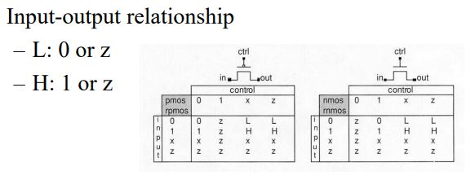
PRIMITIVES FOR MOS TRANSISTORS
nmos, pmos
rnmos, rpmos (resistive version)
Terminal list: (drain, source, gate)
(i.e., (output,input, control))

Slide 17
EXAMPLE: INVERTER
(a) CMOS circuit, (b) in = 0, (c) in = 1

Slide 18
VERILOG MODEL FOR CMOS INVERTER
module cmos_inverter (inv_out, inv_in);
output inv_out;
input inv_in;
supply0 GND;
supply1 PWR;
pmos (inv_out, PWR, inv_in);
nmos (inv_out, GND, inv_in);
endmodule

Slide 19
EXAMPLE: 3-INPUT NAND GATE

Slide 20
GATE-LEVEL MODELING
Gate-level Primitives
Multi-input Gates | Multi-output Gates | Three-state Gates
and | buf | bufif0
nand | not | bufif1
or |  | notif0
nor |  | notif1
xor
xnor

Slide 21
TO VERIFY TRUTH TABLE AND WAVEFORMS OF LOGIC GATES USING GATE LEVEL MODEL
module allgates(inverter_out, and_out, nand_out, or_out, nor_out, exor_out, exnor_out, vin1, vin2);
input vin1, vin2;
output inverter_out, and_out, nand_out, or_out,
nor_out, exor_out, exnor_out;
not inverter1(inverter_out,vin2);
and and1(and_out,vin1,vin2);
nand nand1(nand_out,vin1,vin2);
or or1(or_out,vin1,vin2);
nor nor1(nor_out,vin1,vin2);
xor xor1(exor_out,vin1,vin2);
xnor xnor1(exnor_out,vin1,vin2);
endmodule

Slide 22
TESTBENCH LOGIC GATES:
`timescale 1 ns / 1 ps
module test;
reg vin1, vin2;
wire inverter_out_vin2, and_out, nand_out, or_out, nor_out, exor_out, exnor_out;
integer i;
allgates ag(inverter_out_vin2, and_out, nand_out, or_out, nor_out, exor_out, exnor_out, vin1, vin2);
initial
for(i=0;i<4;i=i+1)
begin
{vin1,vin2}=i;
#5 ;
end
endmodule

Slide 23
TYPES OF PORT ASSOCIATION/MAPPING/BINDING IN VERILOG HDL
There are 2 types
positional
named

Slide 24
1. POSITIONAL
//Binary 1-bit Half Adder
module ha(a,b,sum,co); //actual module
input a,b;
output sum,co;
assign sum = a^b;
assign co = a&b;
endmodule

Slide 25
1. POSITIONAL –Cont’d
When you want to instantiate the above module in Testbench or any Higher level module(for example Binary Full Adder using Half Adder)
You will be doing the following
module name
module instantiation name
port list, such as shown below
module ……;/*It may be testbench or any other higher level module*/
//x,y,sum_result and carry_out are ports in the current module
ha h1(x,y,sum_result,carry_out);//instantiated module
endmodule
If you observe carefully the port list order is same in instantiated module and in the actual module .

Slide 26
2. NAMED
module ……..; /*It may be testbench or any other higher level module*/
……..
………
// x, y, sum_result and carry_out are ports in the current module
ha h1(.co(carry_out), .b(y), .sum(sum_result), .a(x)); //instantiated module
……..
…….
endmodule

Slide 27
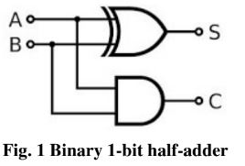
1-BIT BINARY HALF ADDER --GATE LEVEL MODELING
module ha(a,b,sum,co);
input a,b;
output sum,co;
xor (sum,a,b);
and (co,a,b);
endmodule

Slide 28
TESTBENCH: 1-BIT BINARY HALF ADDER
`timescale 1ns/1ps
module ha_test;
reg a,b;
wire sum,co;
ha hadder(a,b,sum,co); /*INSTANTIATE THE MODULE NAME(ha) THAT NEEDS BE TESTED WITH INSTANTIATION NAME hadder*/
initial
begin
{a,b} = 2’b00;
#5 {a,b} = 2’b01;
#5 {a,b} = 2’b10;
#5 {a,b} = 2’b11;
#5 $finish;
end
initial
$monitor($time, “a=%b, b=%b, sum=%b, co=%b” , a, b, sum, co);
endmodule

Slide 29
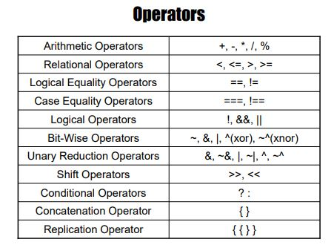
DATA FLOW MODELING -- OPERATORS

Slide 30
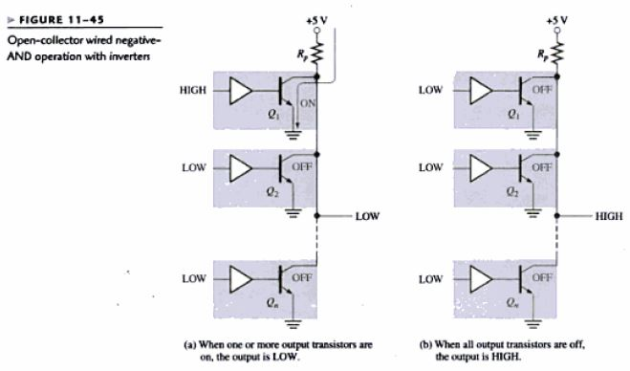
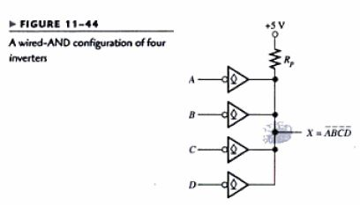
WIRED-AND CONFIGURATION

Slide 31
WIRED-LOGIC
wired logic A form of digital logic in which some logic functions are implemented by directly connecting together the outputs of one or more logic gates. The success of this technique depends on the electronic characteristics of the gates involved. The technique is commonly used in bus communication systems with tri-state output or with open-collector devices.
open-collector device A particular implementation of an electronic logic device in which the output of the device is formed by the open-circuit collector termination of the output transistor (see diagram). The device's output is thus active-low and a pull-up resistor is required to establish the active-high state. These devices are used to drive loads with high supply voltages or to implement wired-logic buses.
pull-up resistor A resistor that is connected between the power-supply line and a logic line and ensures that the line is normally pulled up to the supply potential. Open-collector logic devices may be connected to the logic line and each device is then capable of pulling the line low, i.e. to ground.
tri-state output (three-state output) An electronic output stage consisting of a logic gate, commonly an inverter or buffer, that exhibits three possible logic states, namely logic 1, logic 0, and an inactive (high-impedance or open-circuit) state. The inactive state allows the device outputs to be combined with other similar outputs in a busing structure such that only one device is active on the bus at any one time.

